Slide 1
The Future of Open Source is Trust
Christopher “CRob” Robinson
Director of Security Communications, Intel
@SecurityCRob
#ossummit
Notes:
I wanted to thank Linus for warming the audience up here this morning. Best opening act in showbox, folks! Hello! I am here today to talk to you about TRUST. Some of you may know me, but many of you probably don't. So how can I can come to earn your trust? I always believe that sharing is caring, so here we go!
Obviously *someone* here trusts me enough to shove me out here on stage, right?

Slide 2
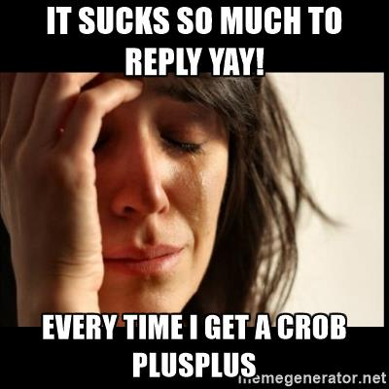
From 2017/09/06 #tam IRC post
Notes:
Trust is earned through demonstrating desired behaviours and earning that respect in every interaction. I assert to you that I have a history of doing interesting and *sometimes* useful things that earned me the trust and respect of the community which enabled me to be in a position to add some value to you all here today. I'll have to start earning your trust today (or reaffirm your existing trust in me) beginning meow!

Slide 3
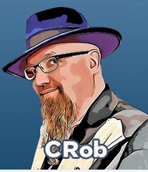
[IE@OSS-EU ~]sh$ ./HelloWorld.
CRob, n, adj, and v Pronunciation: U.S. (K-rowb)
41st level Dungeon Master
24th level Securityologist
Notes:
My handle is CRob, and I am extremely glad to be here with you all here in beautiful historic Dublin, Ireland at the OSS-EU. Dia dhuit! (/JEE-uh ghwitch)
I will next assert to you that open source has ALWAYS been built on a foundation of trust and always will be.

Slide 4
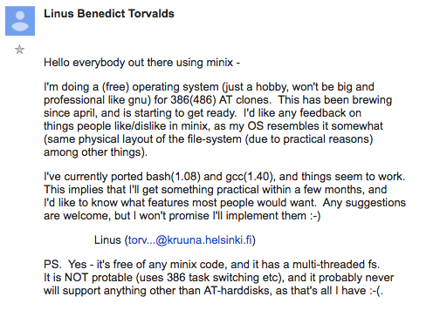
Linux & Open Source were built on a foundation of trust
17Sept1991
Notes:
OSS has always been an interesting, if not sometimes complex, web of trust. 30 years ago when Linus kicked us all off on this amazing journey that saw us all contribute to first a platform to host all these new ideas, but quickly turned into an ecosystem and a way of developing software at scales never before seen.

Slide 5
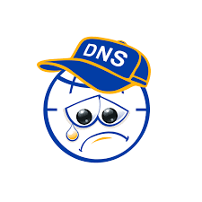
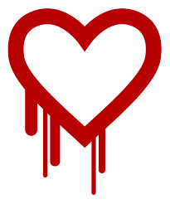


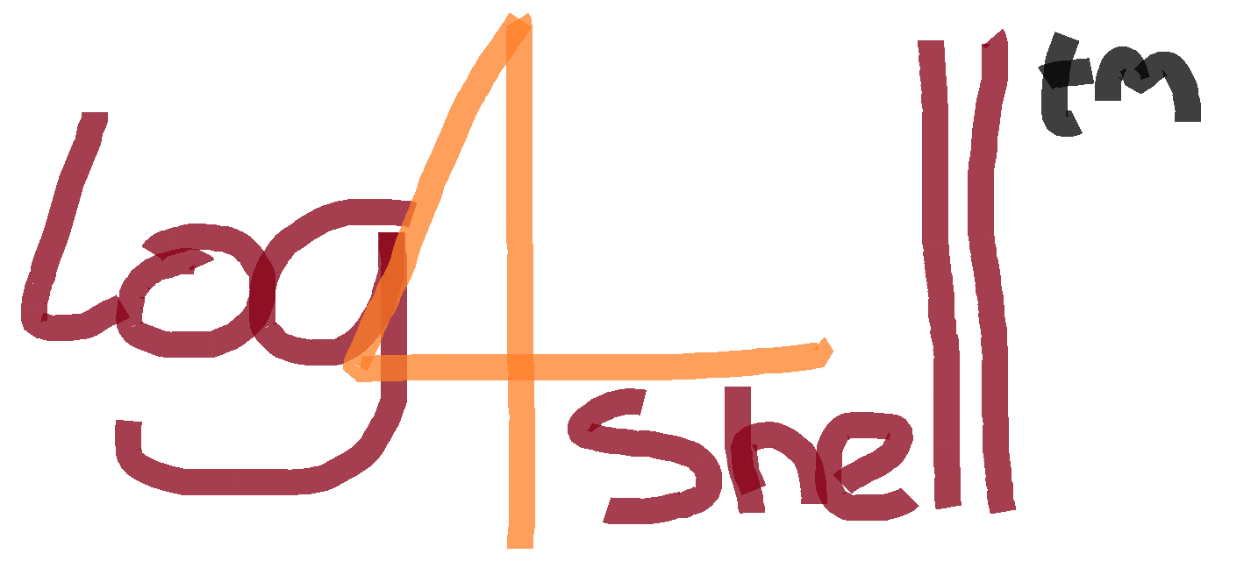

As OSS Evolved, so has the Threat Landscape
CVE-2014-0160
04/07/2014
CVE-2014-6271
09/24/2014
CVE-2016-0800
03/01/2016
event-stream
crypto miner
Sept – Oct 2018
CVE-2020-25705
11/16/2020
CVE-2021-44228
12/10/2021
Notes:
Along the way, the threat landscape changed as adoption of these amazing new tools penetrated further and further into our everyday lives. What at one point was referred to as "a bunch of hobbyists" transformed and evolved into the tools and ideas that the global economy lives by and thrives on
Each time some new vulnerability was found our community came together to fix it. With each new high-profile incident pounding home the notion that WE had become critical infrastructure! These headlines over the last few years about high-profile breaches and incidents also highlights gaps in our trust and understanding.

Slide 6
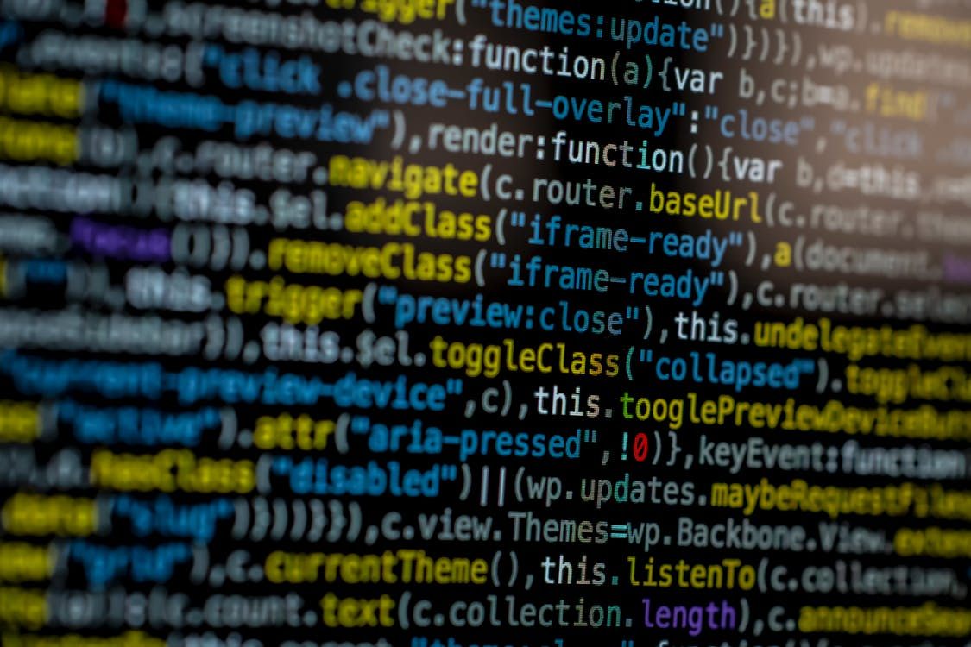
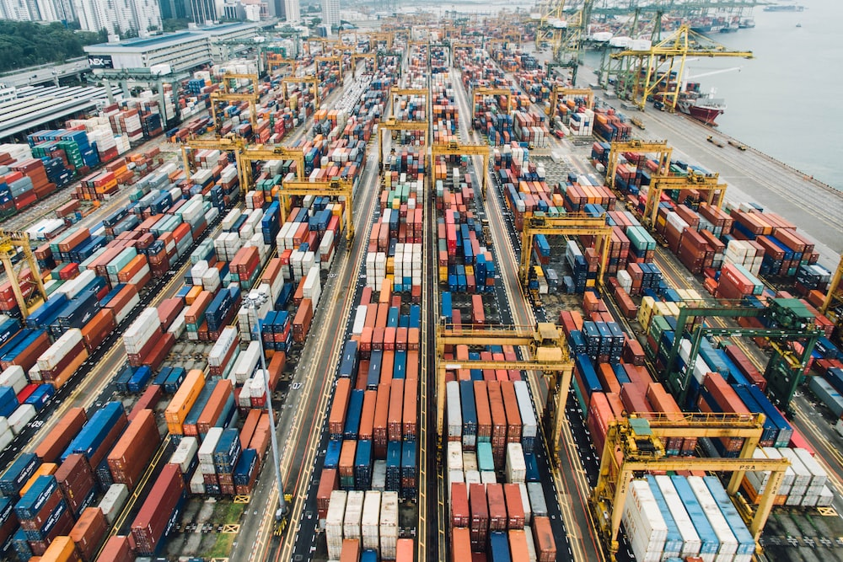
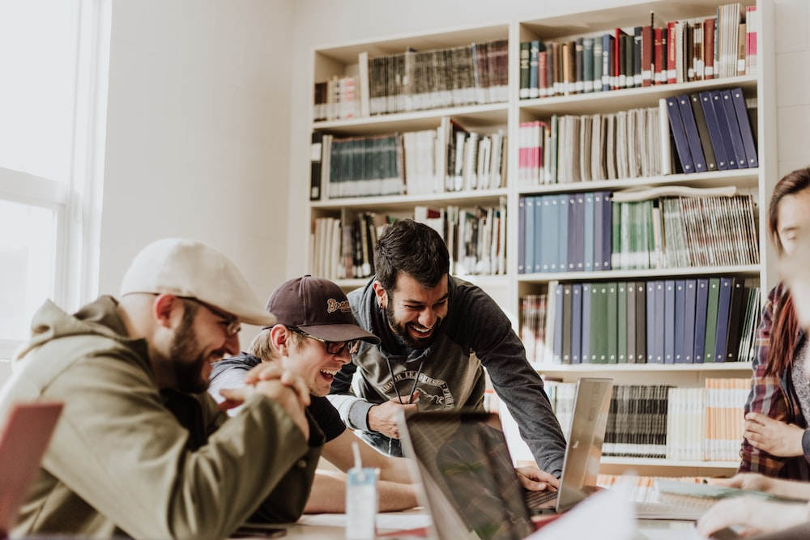

Trust from the foundation, up and down the stack and supply chain
source
source
source
source
Open Source images from Unsplash and Pexels
Notes:
Intrinsically, OSS is built upon communities of individuals coming together, collaborating, to build something wonderful. [move to slide 6 - foundation] One or two person ideas growing into projects blossoming into vibrant communities which impact the whole ecosystem. This requires trust from the foundation, up and down the stack and throughout the supply chain.
This brings me to today, where organizations like mine, who have been contributing to open source communities for twenty years now, came together. Fierce competitors, fast and long-time friends, newcomers, and incumbents all came together in the spirit of trust to help the thing we all so dearly loved.

Slide 7
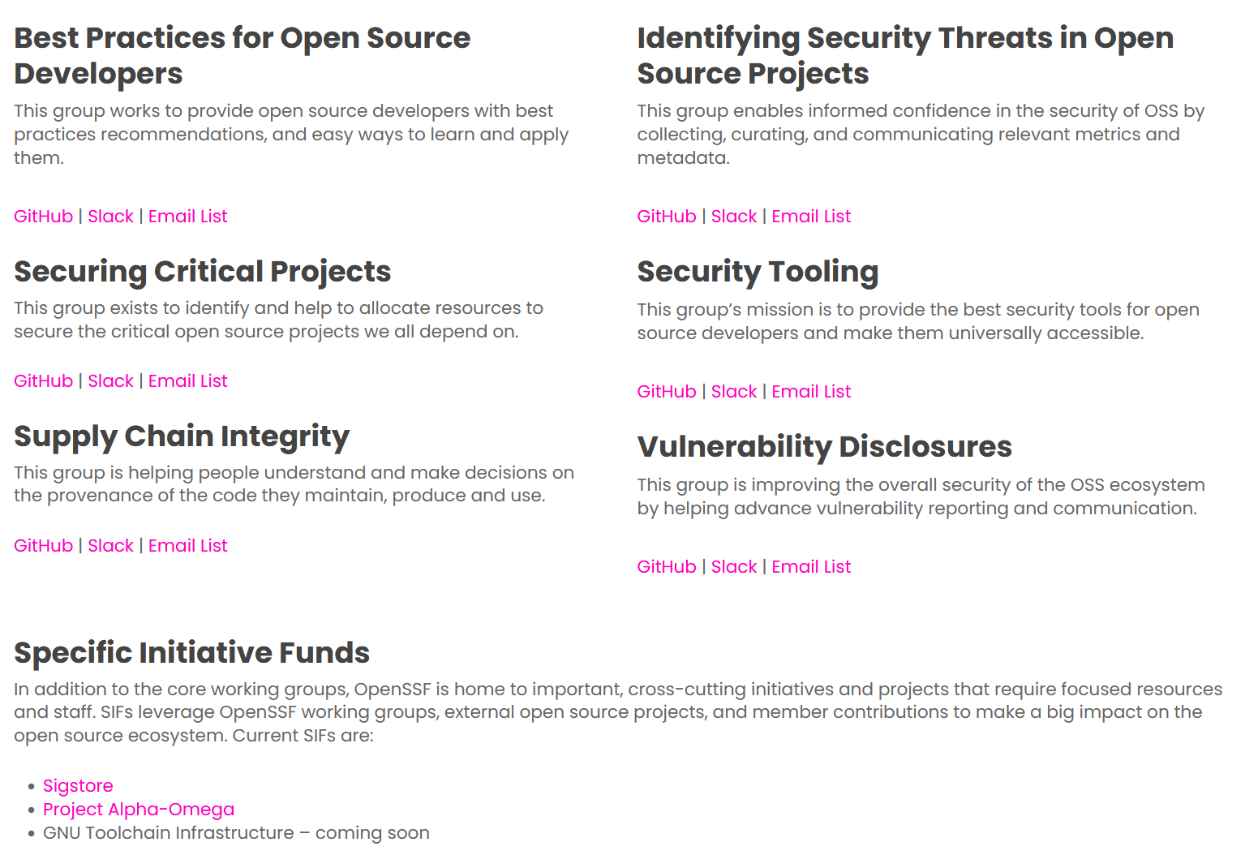
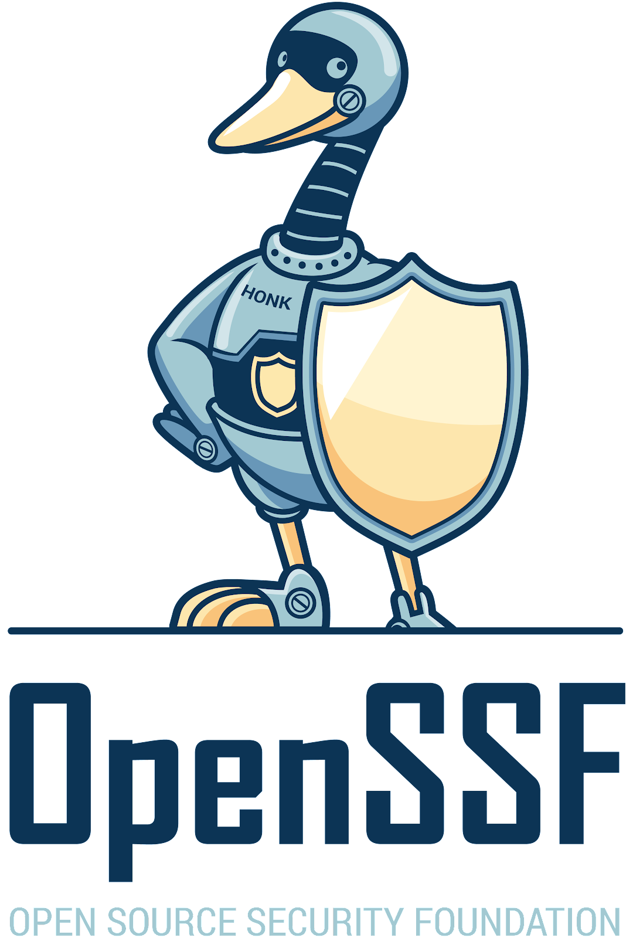
The rising tide lifts all boats
https://openssf.org/community/openssf-working-groups/
Notes:
Building upon the relationships and trust earned in the past, the openssf was formed with the idea of improving the security of the open source software ecosystem and the whole oss supply chain. Corporations, maintainers, researchers, enthusiasts, academics, and individuals have joined together for nearly the last three years focusing on specific security problems. Projects like sigstore, SBOM, SLSA, Badges, Scorecard all have become parts of the story of how the community has banded together to make the WHOLE ecosystem better. Focusing on in key areas that have the potential for maximum benefits for ALL oss maintainers and consumers, OSSF contributors transparently gather to help work on these tough problems.

Slide 8
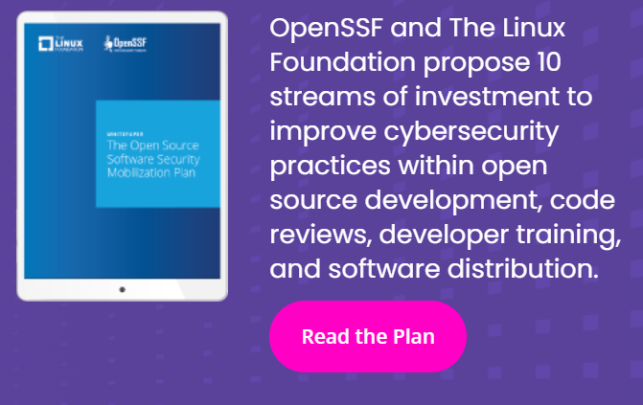

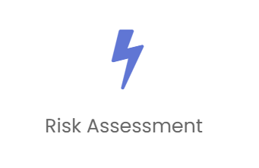

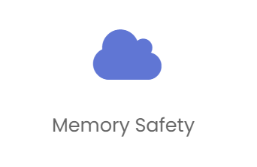
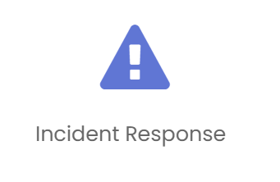
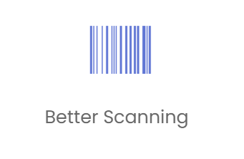
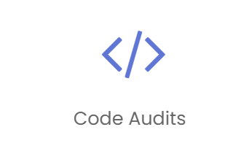
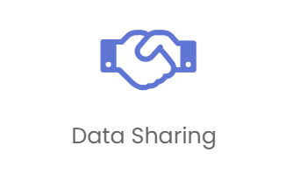
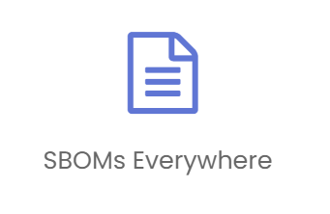
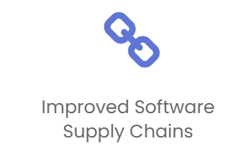
Someone IS doing something!
(and you can help out, too!)
https://openssf.org/oss-security-mobilization-plan/
Notes:
These problems impact virtually everyone. Companies like Intel see the value in participating to help contribute to solving them. Intel has continuously worked to strengthen and grow the future of open source, working with standards, tools, and processes to create trusted expectations in the software, products, and services we these deliver. This is what we and my fellow Geese are striving to bring to all communities.

Slide 9
Eric S. Raymond, one of open source’s founders:
“Given enough eyeballs, all bugs are shallow.”
He called it “Linus’s Law.”
Notes:
So now that I've shared a bit of my story, hopefully demonstrating that I care, ideally I've earned your trust. And I'd ask all of you, my open source family here today and on the intertubes out there, to please join us and help solve these immensely important problems

Slide 10

We Are Building Trust
@OpenAtIntel
Notes:
I hope everyone had some craic and learned to trust each other just a wee bit more! Thank you for your time and attention, I trust I'll be seeing you contributing to help us strengthen our foundation and make things more secure for everyone.

